Slide 1
Section 3: Single Displacement Reactions Thanks to North Allegheny School District, Pittsburgh, PA
Chapter 6: Chemical Reactions

Slide 2
Learning Goals
Identify and predict single displacement reactions.

Slide 3
Single Displacement Reactions
In a single-displacement reaction, one element displaces another in a compound.
Single displacement reactions follow this general equation:
A + BC → AC + B

Slide 4
Single Displacement Reactions
In single-displacement reactions, one metal can replace hydrogen or another metal.

Slide 5
Single Displacement Reactions
A metal will not always replace a metal in a compound dissolved in water because of differing reactivities.
An activity series can be used to predict if reactions will occur.

Slide 6
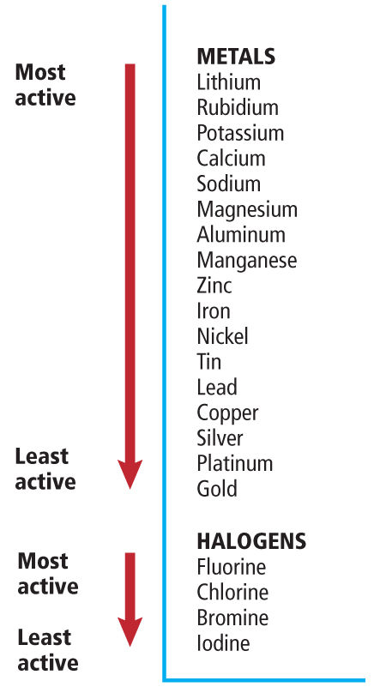

Slide 8
Single Displacement Reactions
Halogens frequently replace other halogens in replacement reactions.

Slide 9
Single Displacement Reactions
Halogens also have different reactivities and do not always replace each other.
An activity series can be used to predict if reactions will occur.

Slide 11
Predicting Products
Identify which two elements would be likely to swap.
Consult the activity series to see which element is more reactive.
If the free element is more reactive, it will trade places with the element in the compound.
If the free element is less reactive, no reaction will take place.

Slide 12
Practice
Predict whether the following single displacement reactions will occur. If a reaction occurs, write a balanced equation for the reaction.
K(s) + ZnCl₂(aq) →

Slide 13
Practice
Cl₂(g) + HF(aq) →
Fe(s) + Na₃PO₄(aq) →
Al(s) + Pb(NO₃)₂(aq) →

